Slide 1


Slide 2



Slide 3
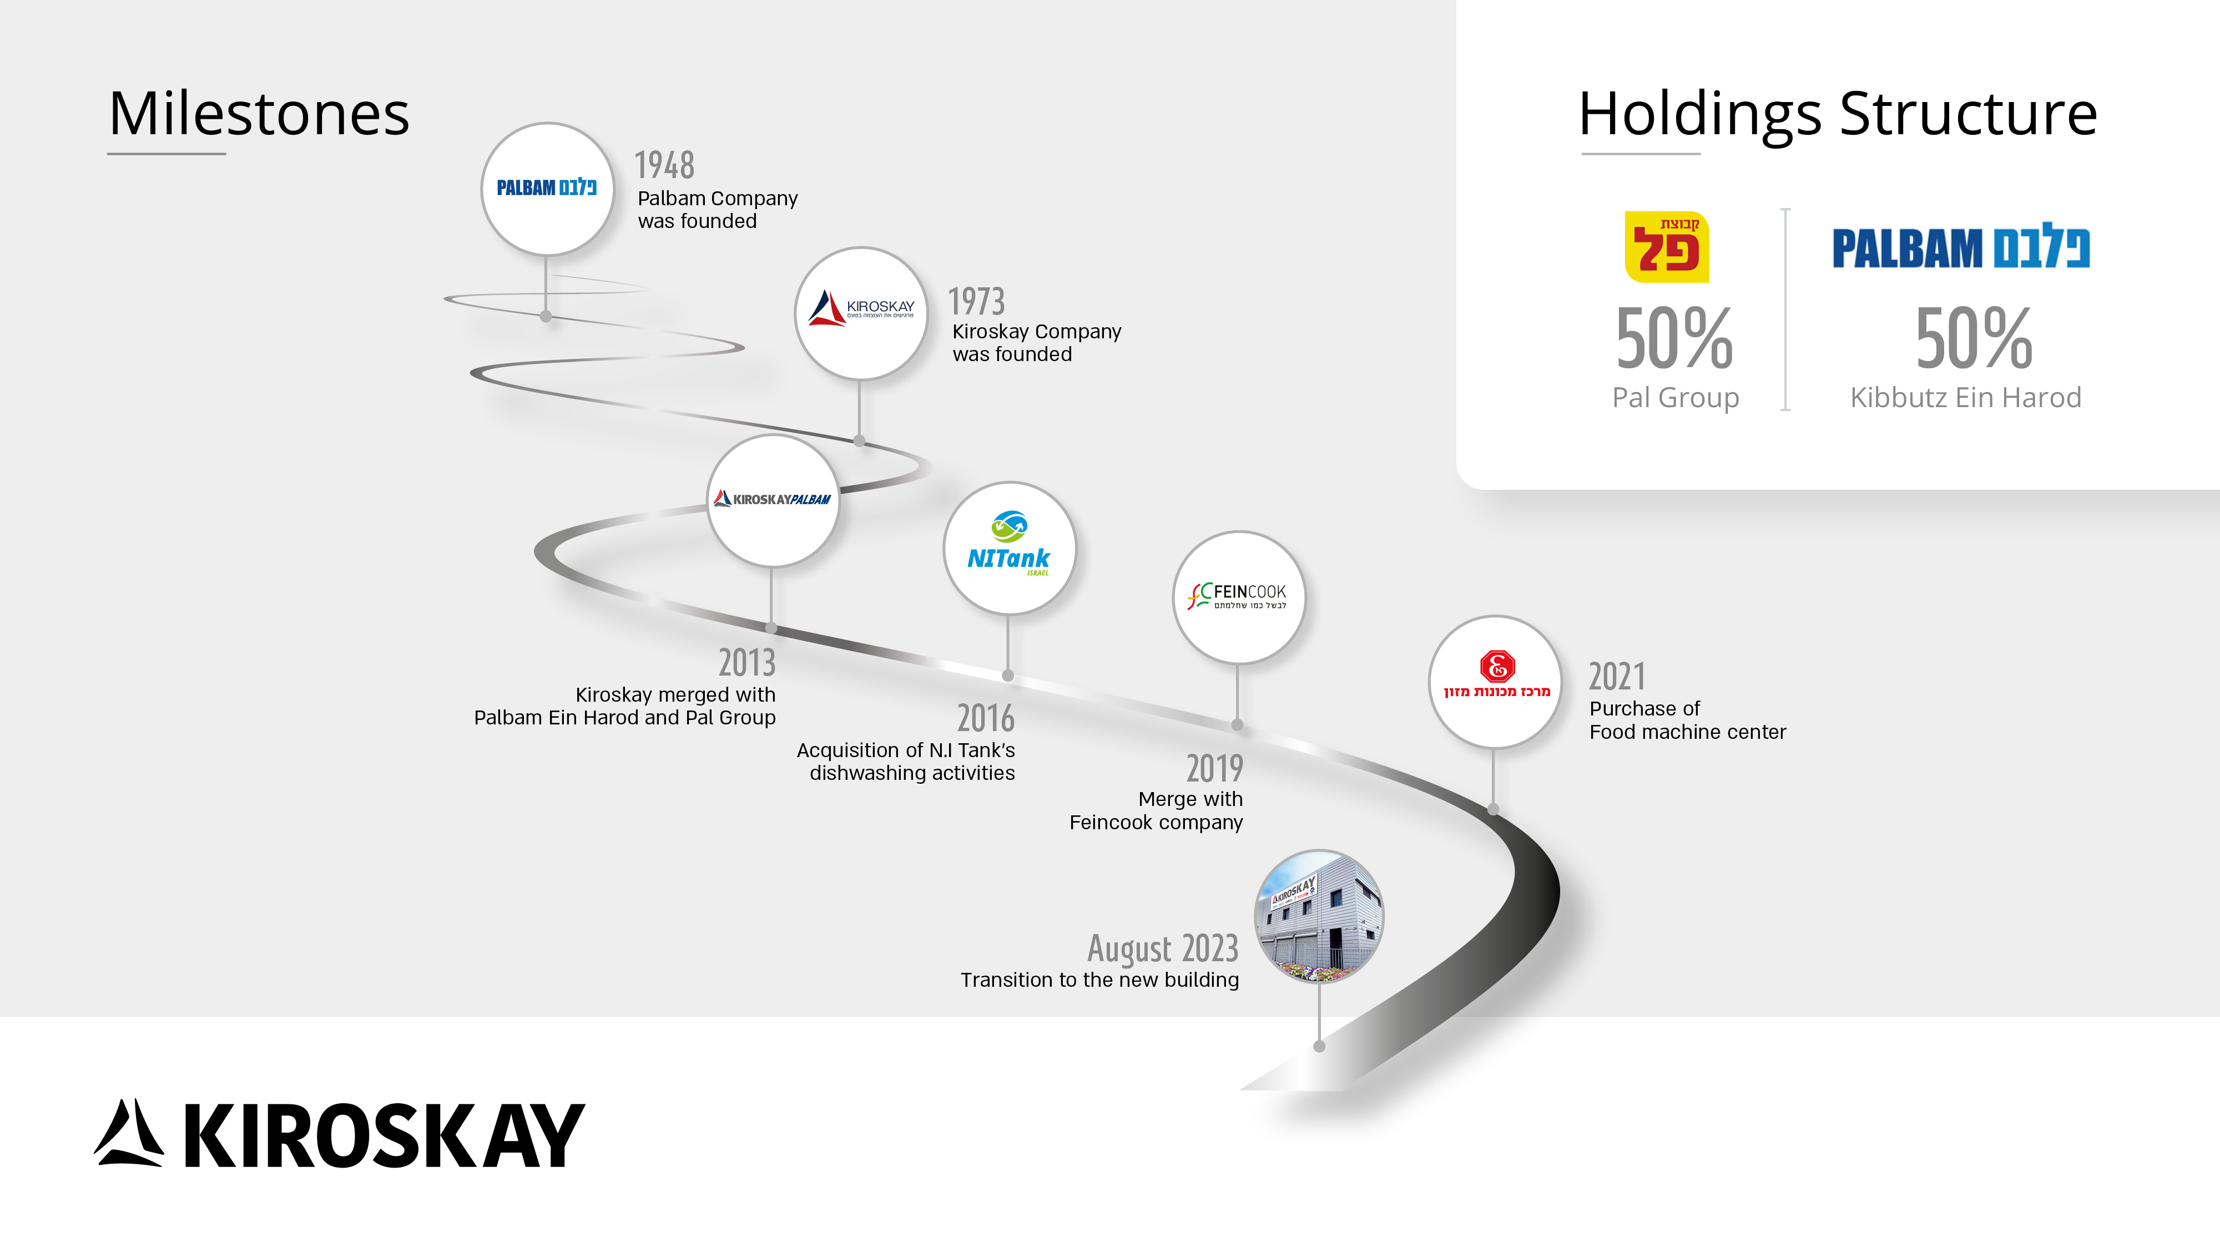

Slide 4






Slide 5
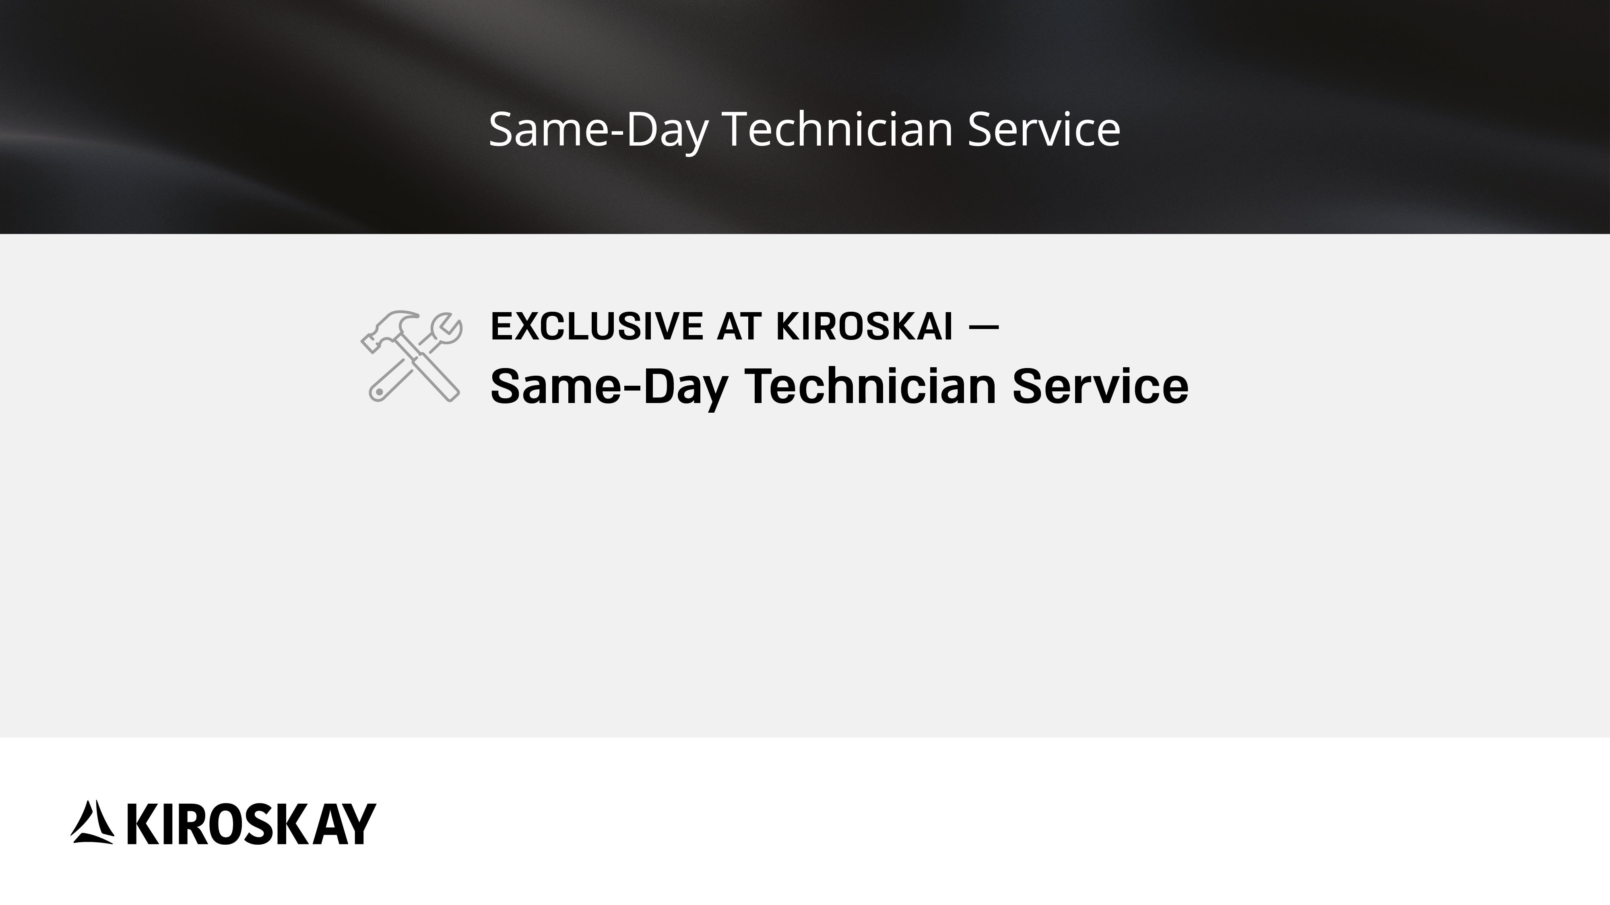
* For calls made before 9:00 am
* For appliances purchased in 2026
* Service available between Hadera to Be’er Sheva

Slide 6
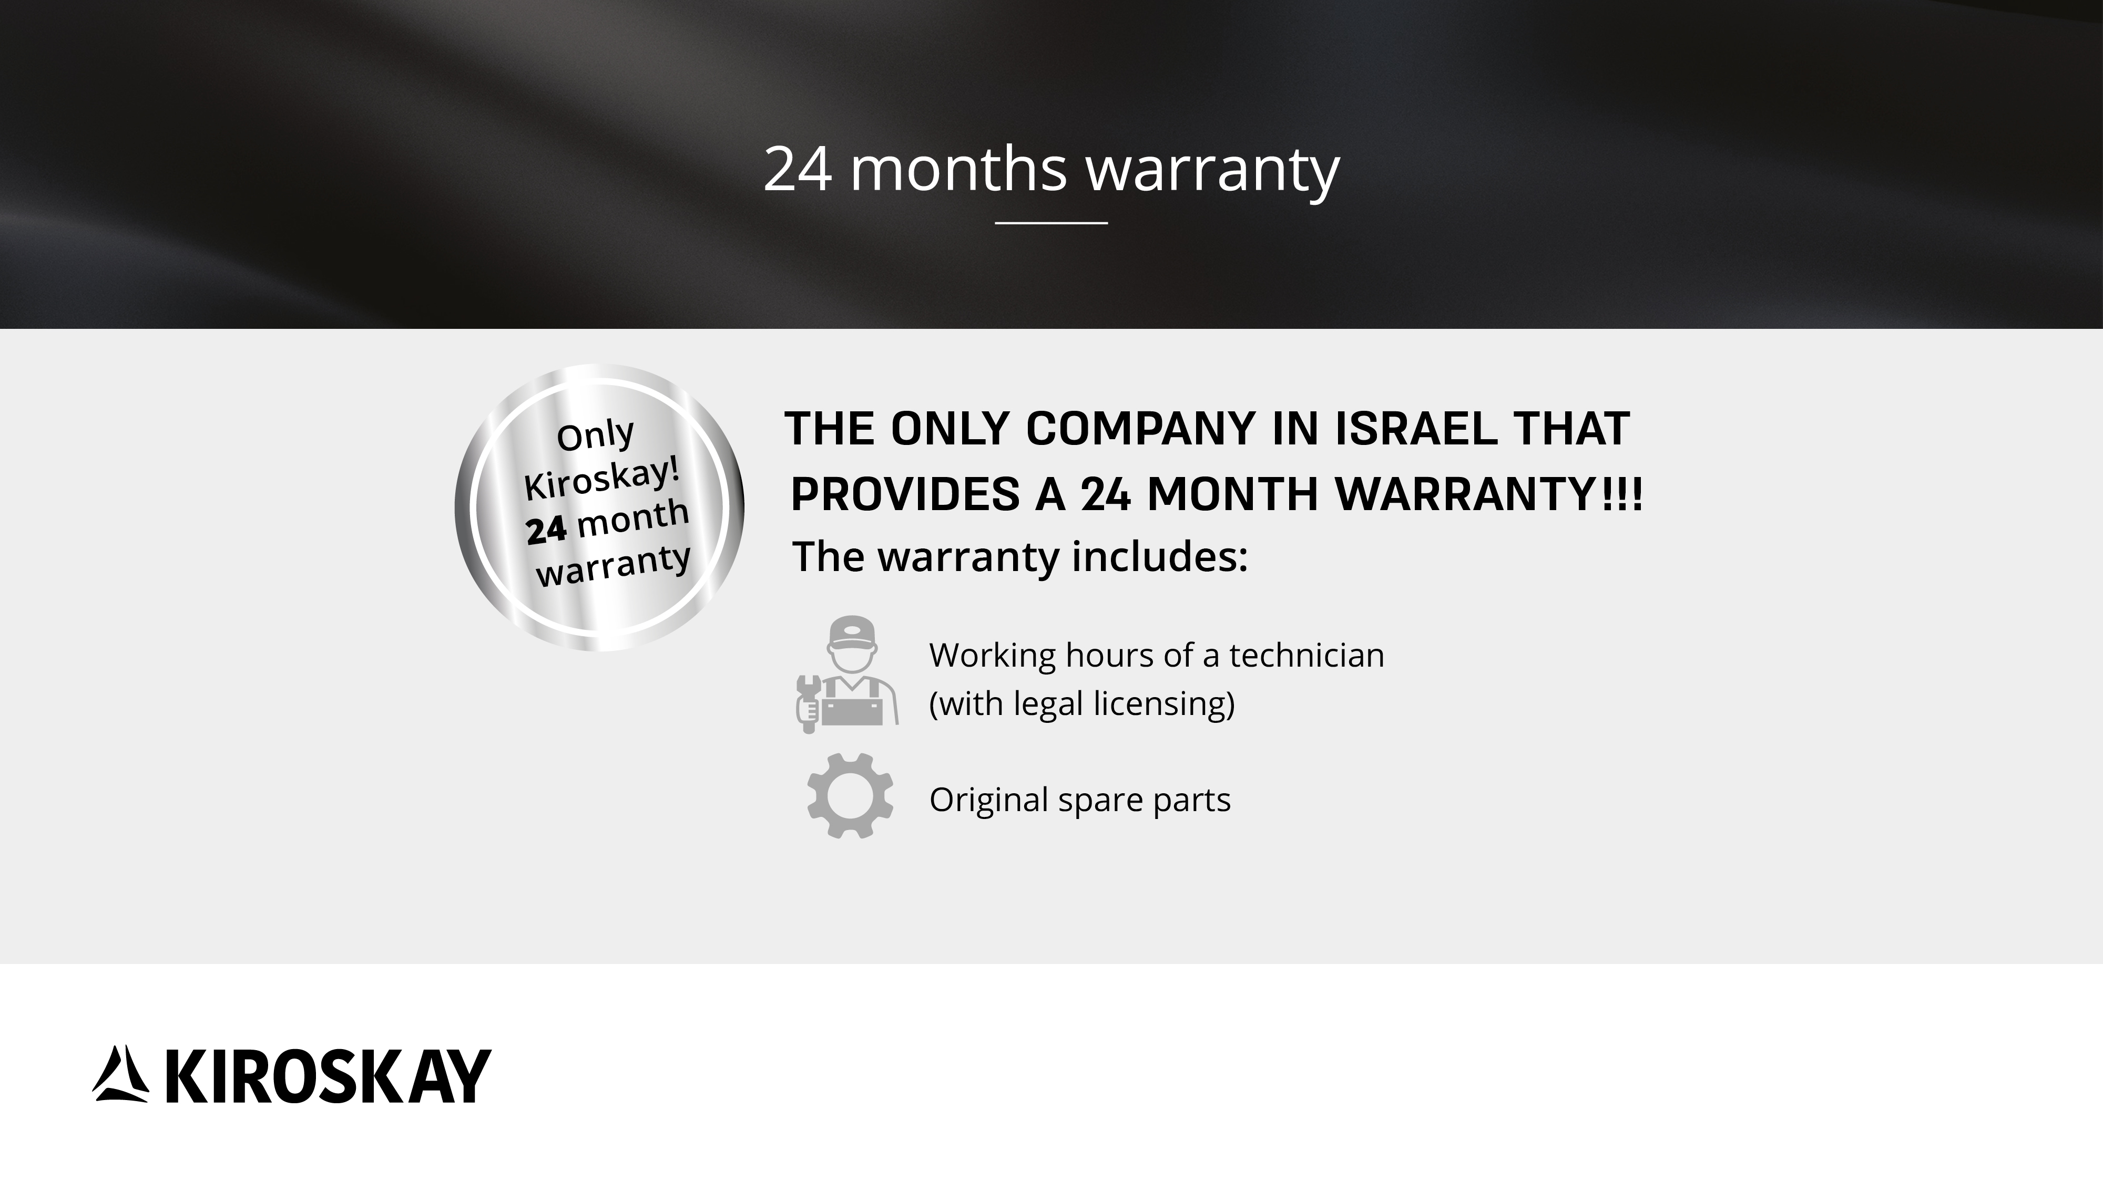
* No small print

Slide 7
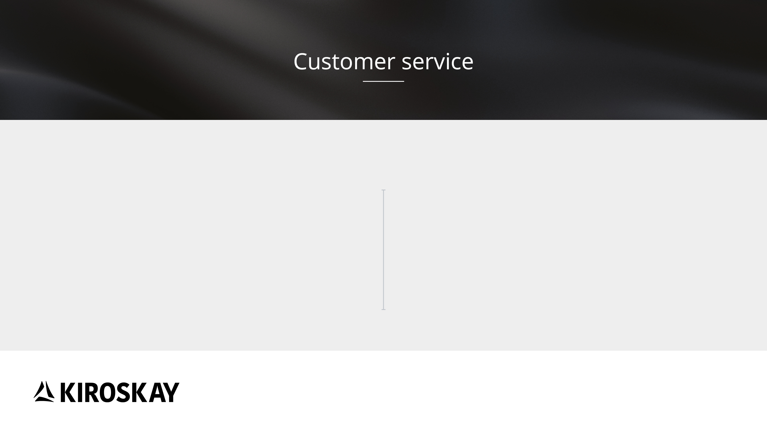
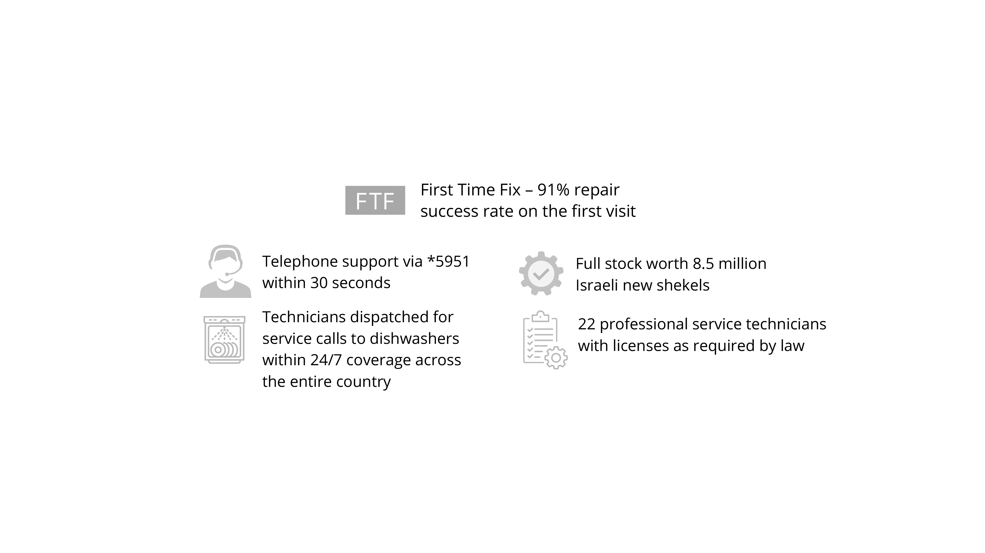

Slide 8
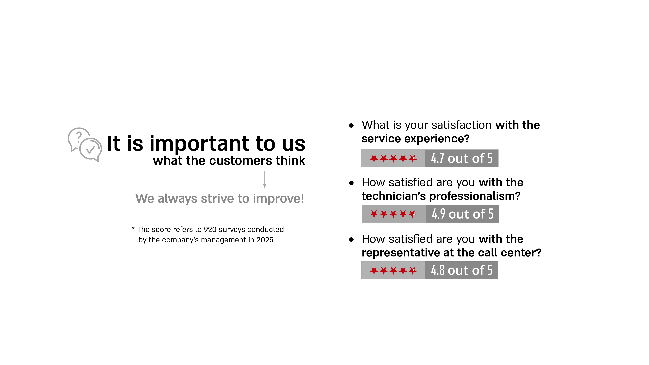
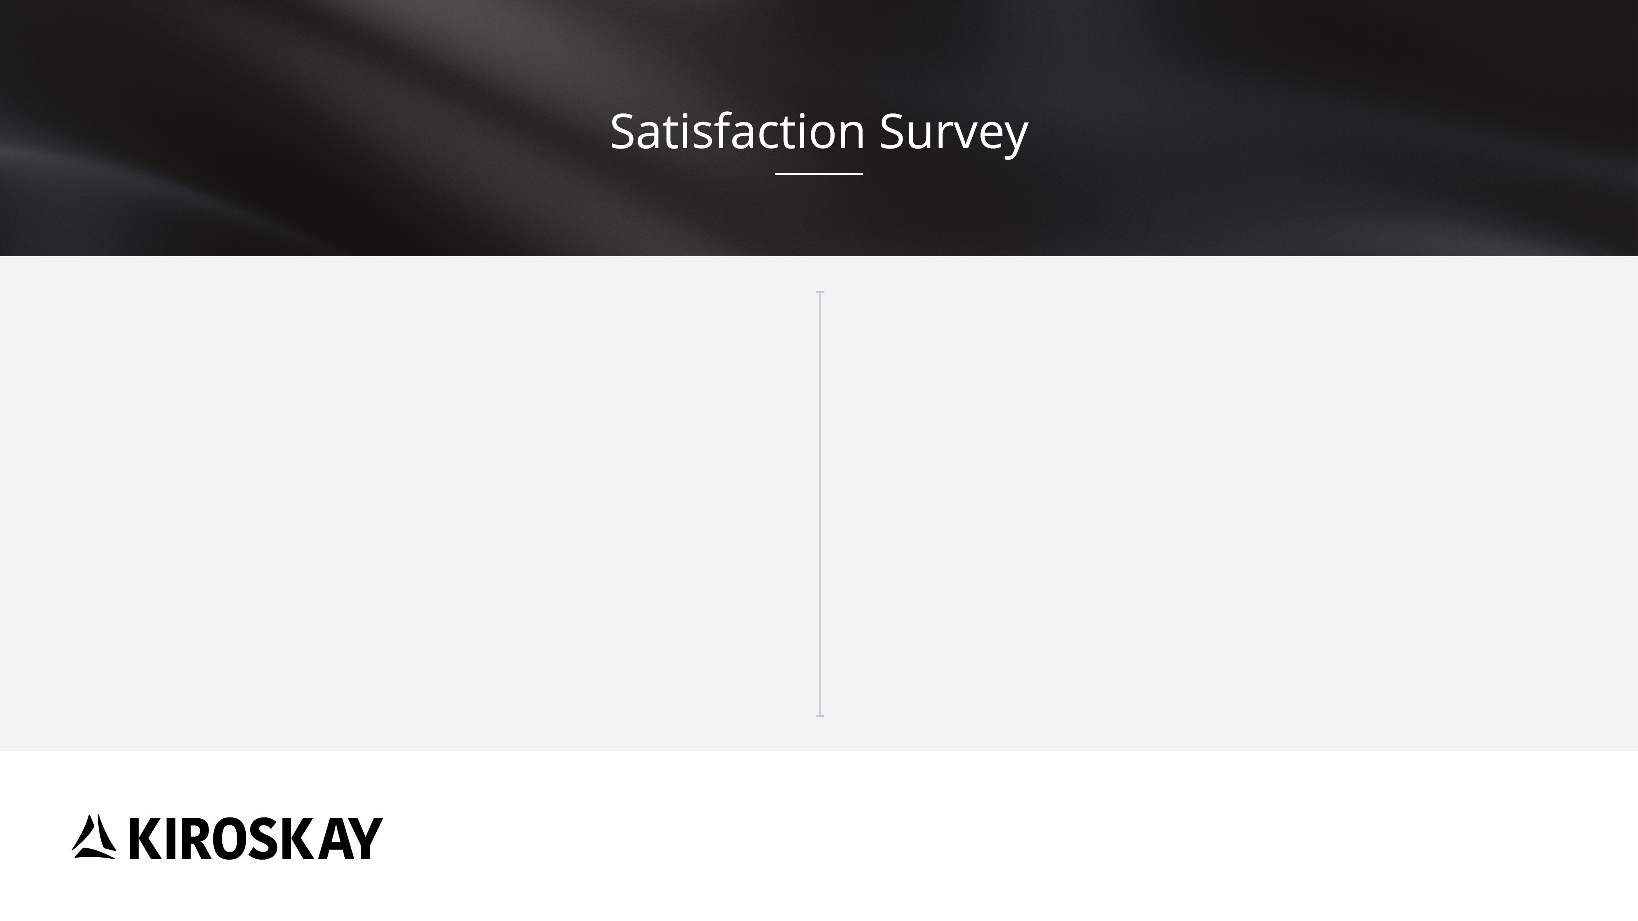

Slide 9



Slide 10


Slide 11


Slide 12
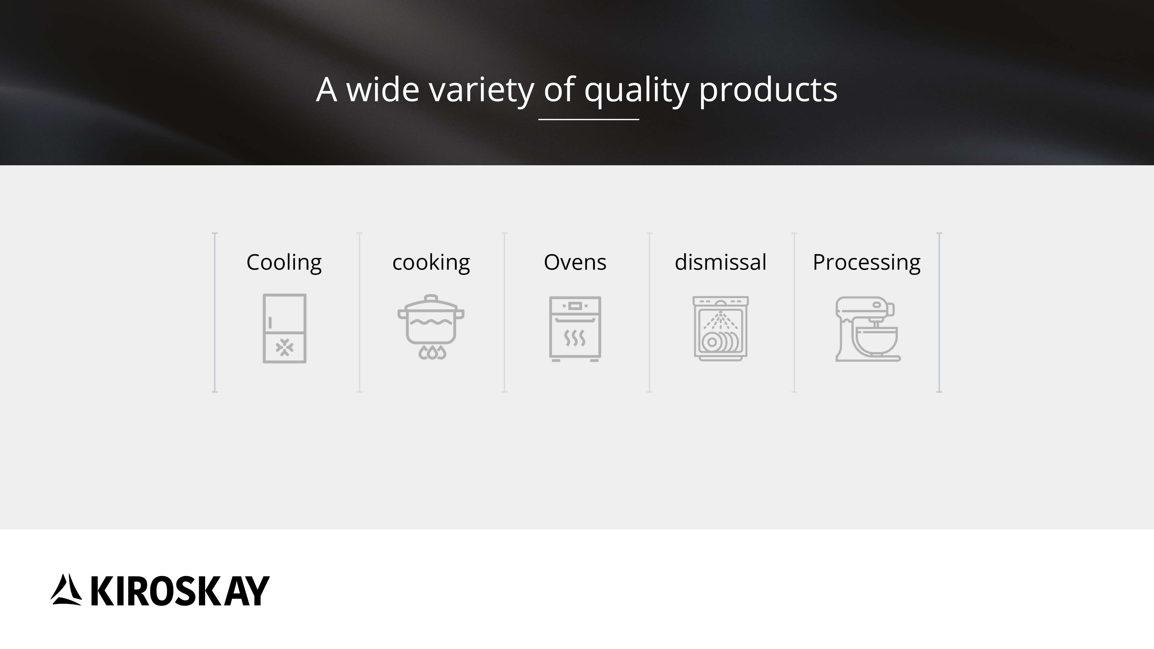

Slide 13



Slide 14


Slide 15
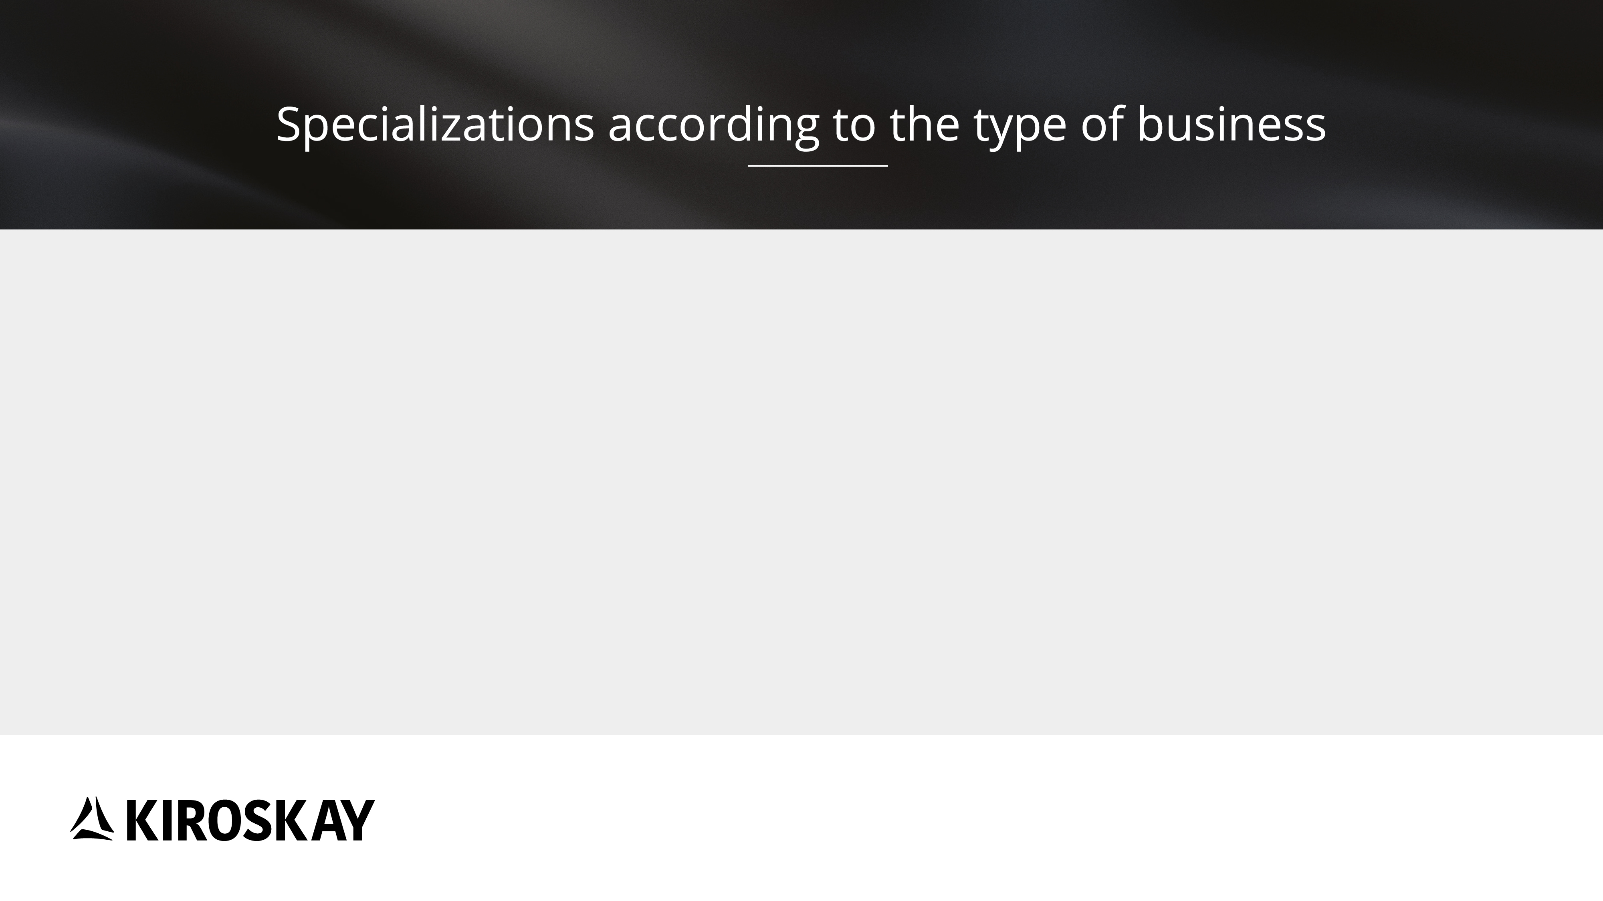






Slide 16


Slide 17


Slide 18


Slide 19
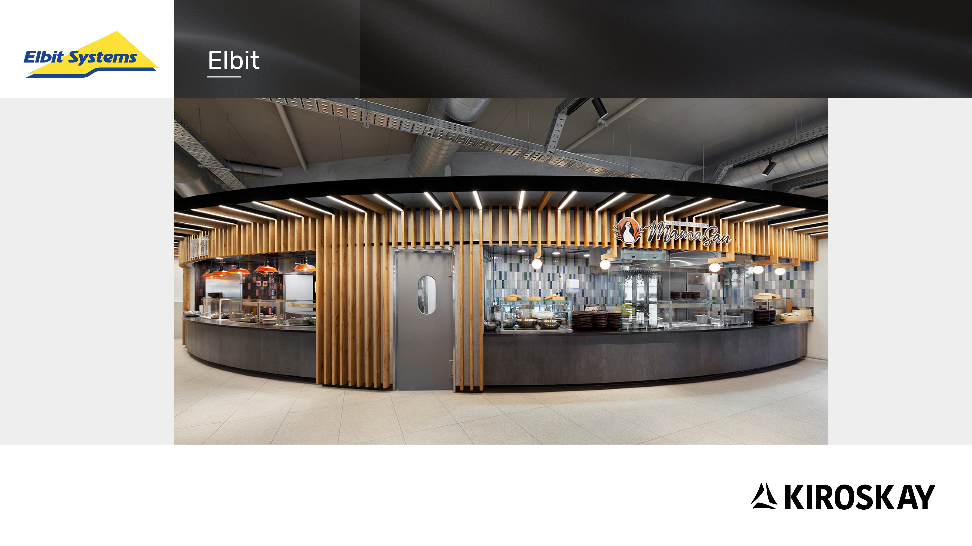

Slide 20
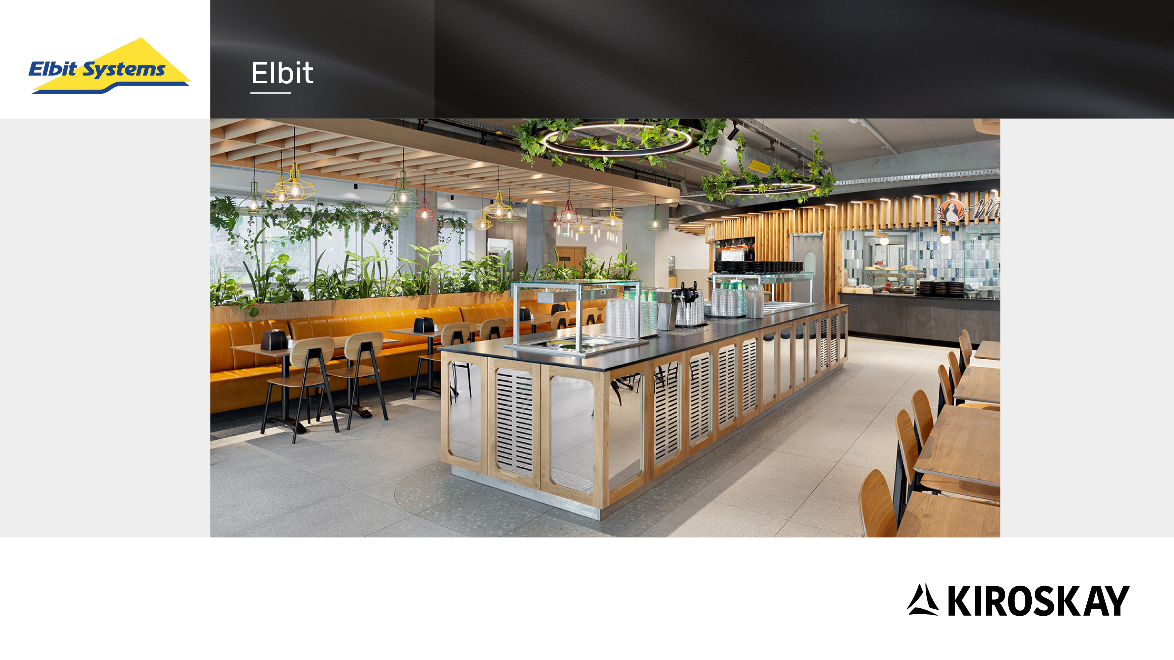

Slide 21
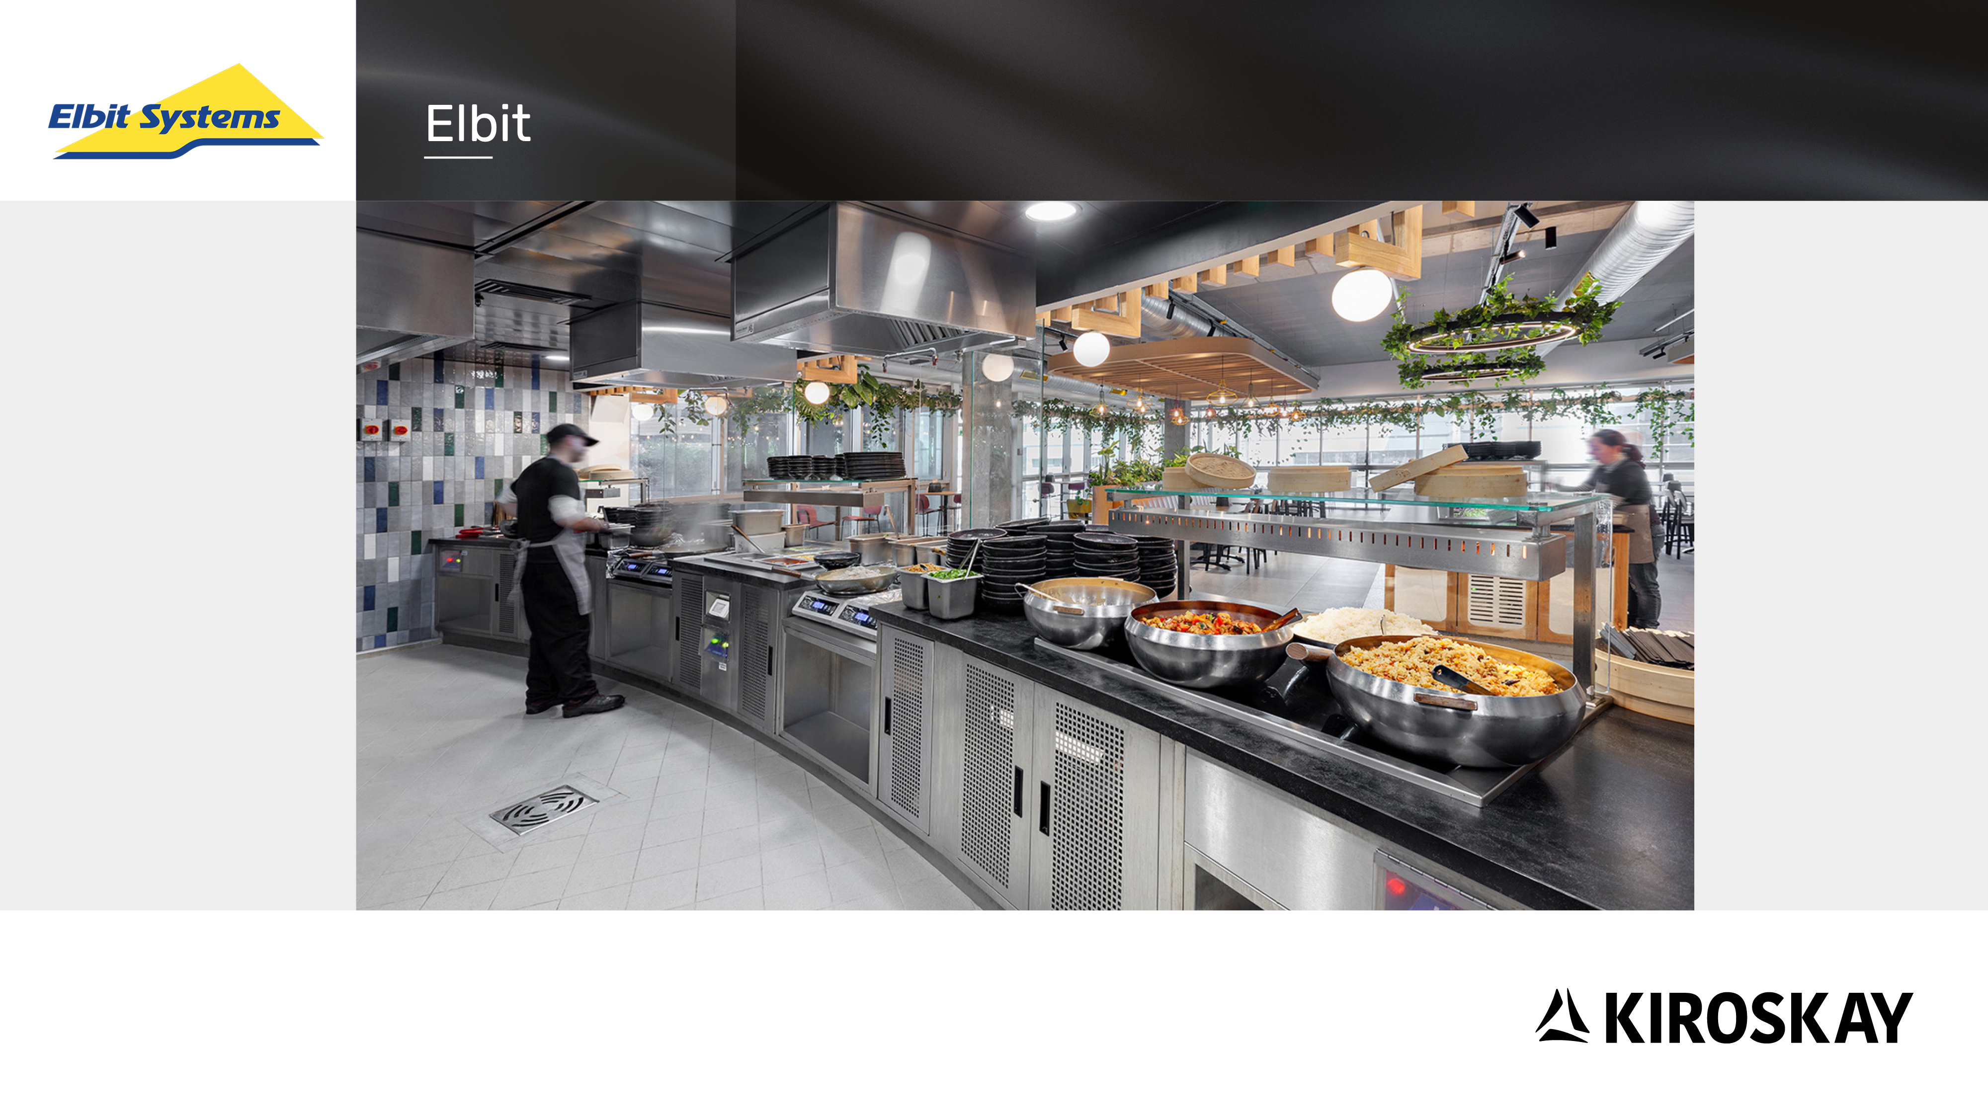

Slide 22


Slide 23


Slide 24
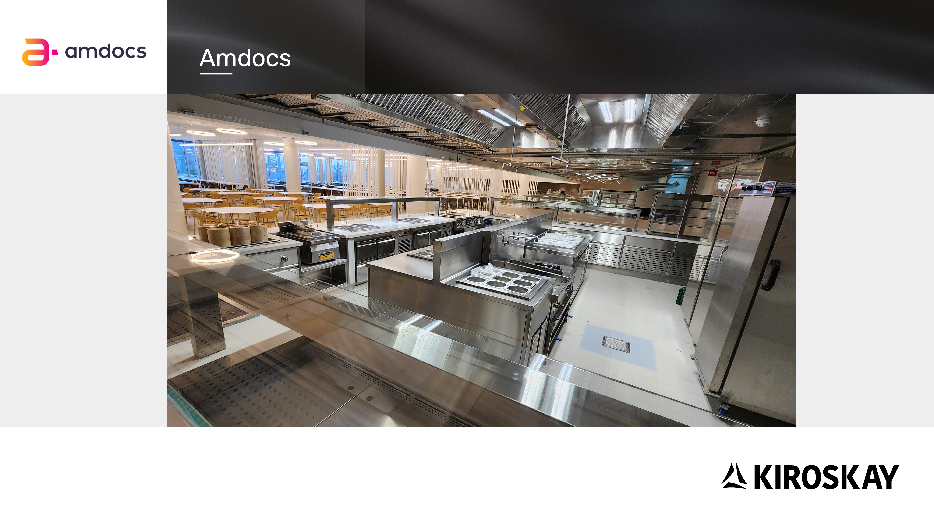

Slide 25
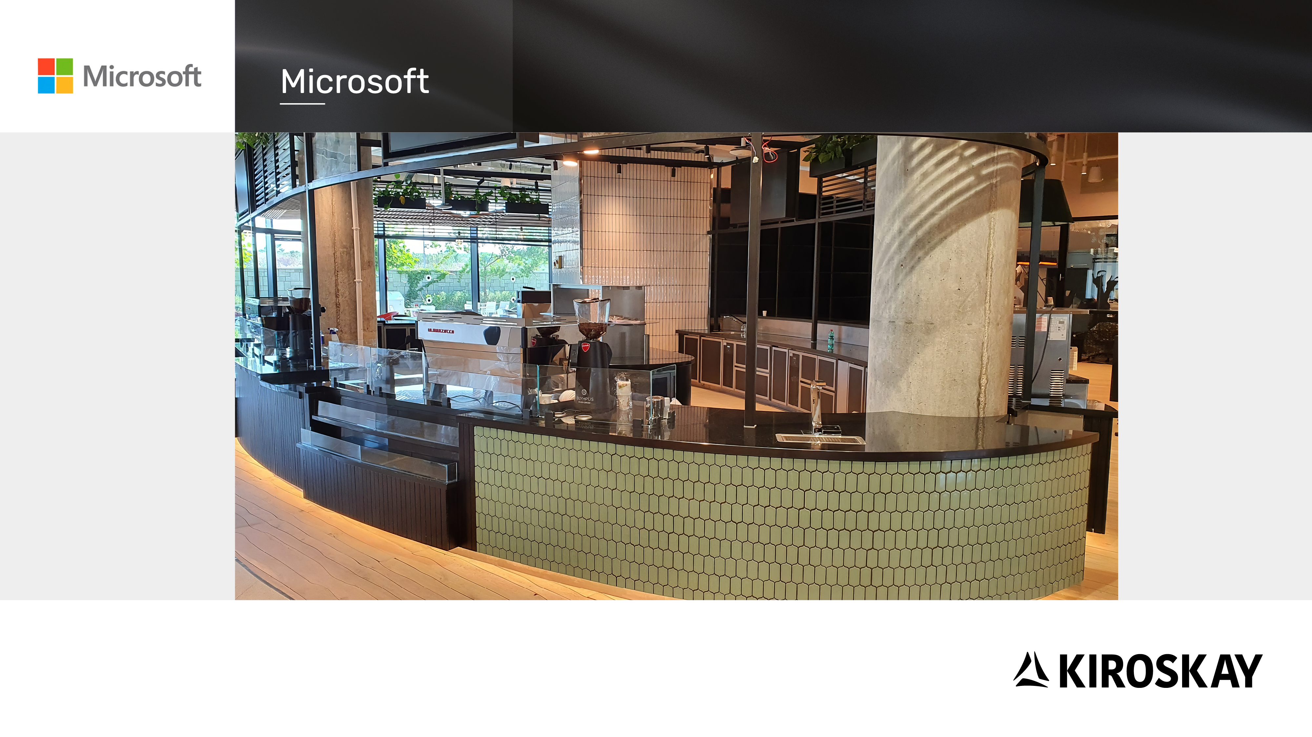

Slide 26
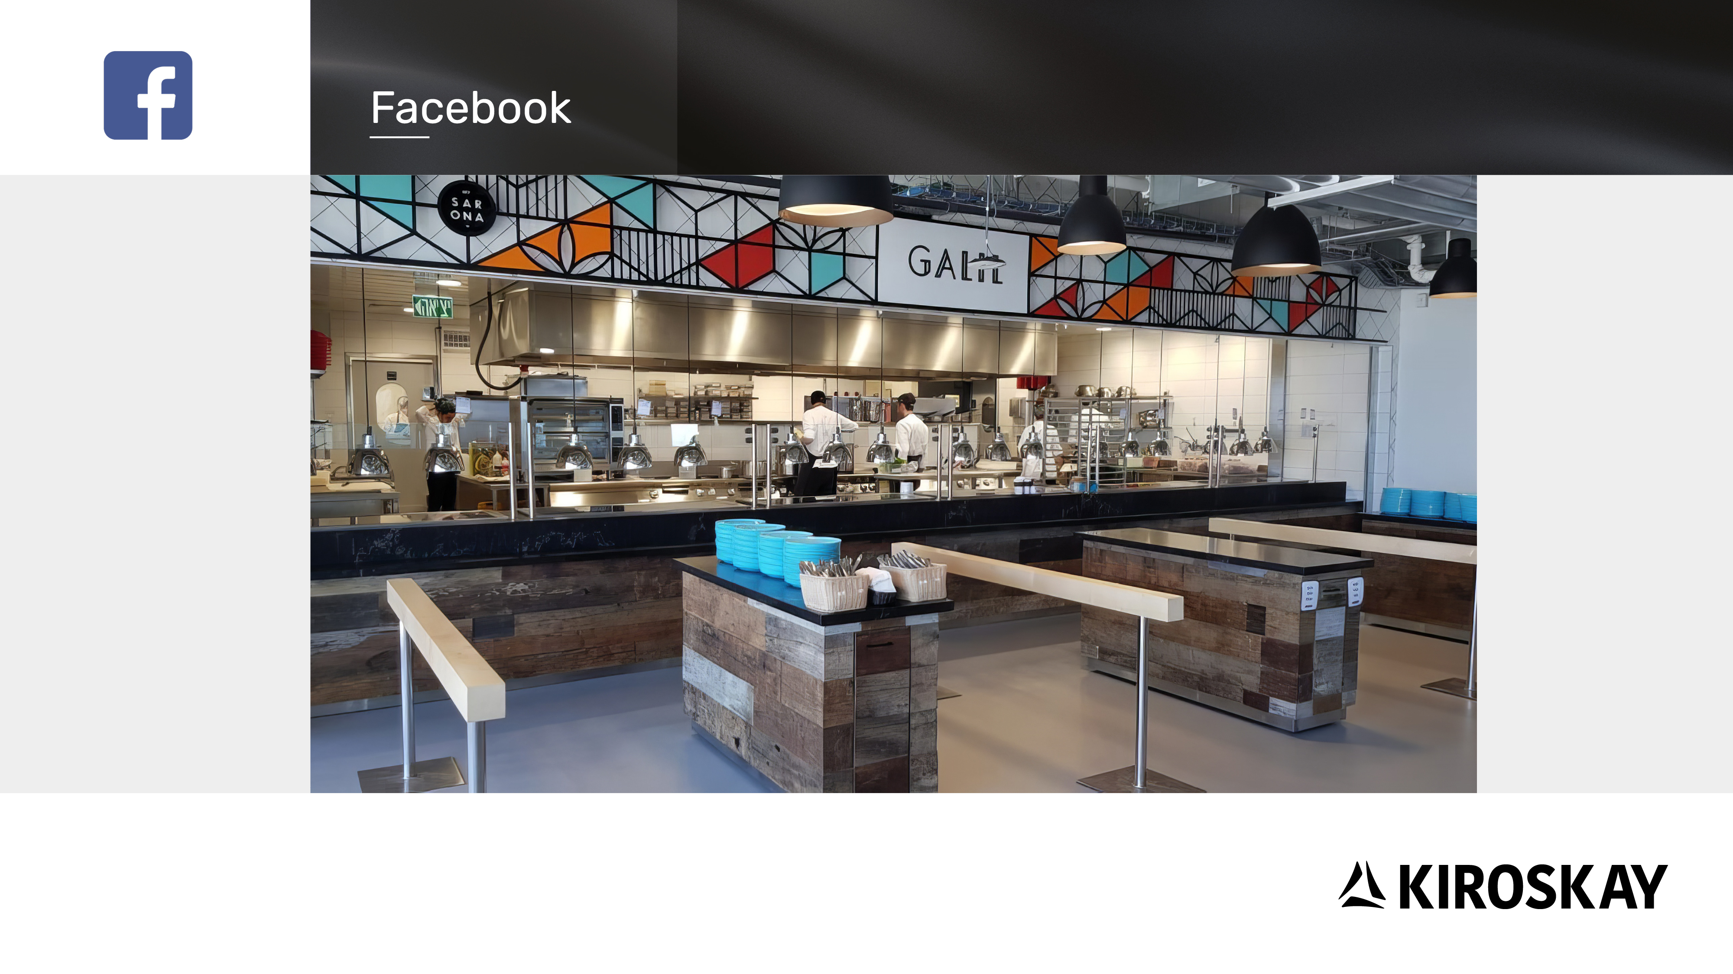

Slide 27


Slide 28


Slide 29


Slide 31


Slide 32
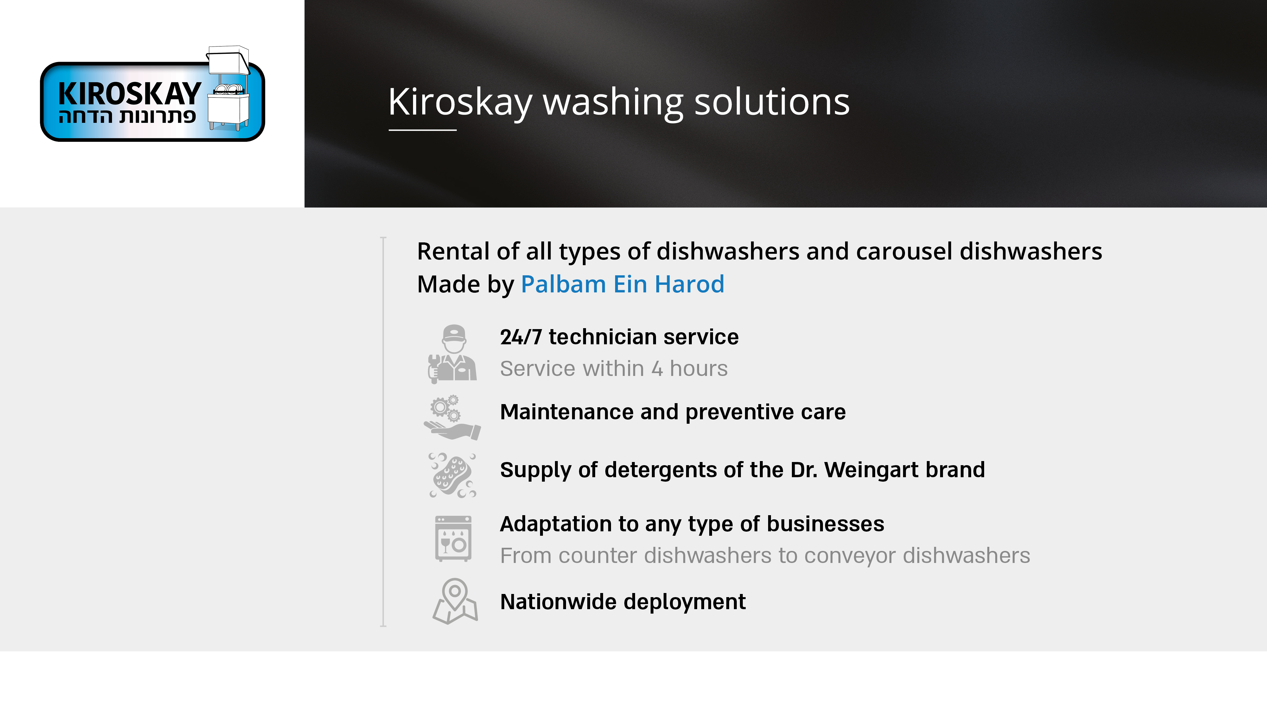

Slide 34


Slide 36


Slide 37


Slide 38
